Slide 1
Selecting AI Logistics Tools for Cross-Border Trade Between Canada and Africa
Breck Onwona Agyekum
Gate 1 (MEng.) Project presentation
Technology Innovation Management
August 19th, 2025
Notes:
1

Slide 2
Objectives and Deliverables
Objective
Deliver a decision-support package & implementation plan to identify, classify, and evaluate AI-driven logistics tools for ATD’s Canada–Africa non-perishables corridor (serving Canadian wholesalers of non-perishable goods and African suppliers), enabling selection of the most suitable tools and measurable improvements in efficiency and scalability, while streamlining operations and minimizing overhead.
Deliverables
PRISMA-ScR compliant scoping literature review of what is known about AI logistics tools relevant to small trade facilitators
Classification system that groups logistics tools by functionality and the specific supply chain challenges they address.
Tool Evaluation Matrix that assesses shortlisted AI tools against specific criteria
AI-First Implementation Roadmap – A step-by-step guide tailored to ATD for adopting and integrating selected tools
onwonaagyekum@cmail.carleton.ca
Slide 2
July 29th, 2025

Slide 3
Relevance to the Client Company
Client
ATD is a small Ottawa-based organization that facilitates trade between Canadian wholesalers and African suppliers. Susan Namulindwa and Victoria Schorr lead ATD’s efforts in trade enablement.
Evidence of Interest
ATD works in a fast-paced logistics environment where timely decisions matter. The client specifically requested help identifying cost-effective AI logistics tools to support Canadian businesses trading in Africa. Key challenges include customs delays, tracking gaps, and paperwork-heavy processes.
Potential Value to ATD
Increase attractiveness of investing in ATD
A tailored overview and classification of relevant AI logistics tools
A decision-support framework to guide tool recommendations
Reduced implementation risk and improved workflow efficiency
Stronger positioning as a trusted advisor to Canadian SMEs
Relationship to Client
This project was initiated by the supervisor in collaboration with ATD. It combined academic research with practical insights, offering real-world value to a potential employer or partner.
onwonaagyekum@cmail.carleton.ca
July 29th, 2025
Slide 3

Slide 4

Problem and Gap
Client problem : ATD wants to adopt AI-driven logistics tools to better connect African suppliers with Canadian wholesalers. However, it lacks the internal capability to identify, evaluate, and implement suitable technologies—leading to poor decisions and limited scalability in cross-border operations.
What is Known
AI improves logistics performance, enhancing speed and visibility through tools like tracking and automation (Wang et al., 2022).
Small and medium size businesses (SMBs) face adoption barriers such as high costs, poor integration, and limited technical capacity, especially in Africa-focused trade (Saghafian & Van Oyen, 2023).
Multi-criteria decision analysis (MCDA) supports effective tool selection based on cost, usability, and scalability (Kabir & Sadiq, 2021).
What is Not known
What is known about AI logistic tools in the grey literature? (Deliverables 1)
Assessing what is known about AI logistic tools used to facilitate trade between Canada and multi-African countries? (Deliverables 1)
Which AI tools can satisfy ATD’s need to support small teams? (Deliverables 2)
Which tools are cost-effective, scalable, and usable by small teams? (Deliverables 3)
What is not known about how AI-First strategies can be implemented by small trade facilitation teams operating between Canada and multiple African countries? (Deliverable 4)
July 29th, 2025
Slide 4
Notes:
4

Slide 5
Literature review
Stream | Key highlights of the stream | Citations to key sources
Functional Capabilities of AI in Logistics | AI tools automate routing, tracking, and documentation. Enhance logistics efficiency and reduce manual effort. Supports ATD’s tool classification and performance matrix | Al-Obeidat et al. (2023) Wang et al. (2022)
Fit-for-Purpose Design for Canada–Africa Trade | Tools must operate in low-infrastructure African settings. Design must consider connectivity and hardware limitations. Informs ATD’s scoping review of regional implementation. | Kobo360 (2023) UNECA (2023)
Usability & Scalability for Small Teams | SMEs need tools deployable by 1–5 users. Ease of use reduces training burden for lean teams. Feeds into usability scoring in ATD’s evaluation matrix. | Planet Crust (2024) Rahman & Tetteh (2024)
Cost-Benefit Transparency & Financial Reporting | AI tools should show clear ROI and financial reporting features. Cost transparency helps justify investments for SMEs. Supports ATD’s tool evaluation on cost transparency. | Jetvision AI (2024) Petrudi et al. (2022)
Customs, Compliance, and Paperwork Automation | Automation reduces customs paperwork and delays. Improves regulatory compliance and border efficiency. Helps ATD streamline cross-border trade operations. | CB Insights (2024) UNECA (2023)
AI-First Implementation Roadmap for Trade Facilitation | Positions AI tools as operational agents, not add-ons. Uses phased approach: tool selection → piloting → SOP integration. Supports ATD’s transition to AI-driven operations using lean workflows. | Furrier (2024) Mollick (2025) TIM-TiE (2025)
PRISMA-ScR Scoping Review of AI Logistics Tools | Used PRISMA-ScR and PCC framework to review academic and grey literature on AI tools. Identified 65 tools relevant to small trade facilitators in Canada–Africa trade. Informed Deliverables 2–4 by mapping tool features, functions, and regional fit. | Briter Bridges (2022) Tricco et al. (2018) World Bank (2023)
onwonaagyekum@cmail.carleton.ca
July 29th, 2025
Slide 5
Notes:
5

Slide 6
Research Method
Combines a scoping literature review and multi-criteria decision analysis (MCDA) to identify, classify, and evaluate AI logistics tools for Canada–Africa trade
Step | Activity | Outcome
1 | Collaborate with the client to define the review question using the PCC framework and set inclusion criteria (e.g., date range, markets, language, source types) | Scoping parameters and a PRISMA-ScR–compliant review protoco
2 | Search across academic databases, industry reports, and grey literature to identify relevant AI logistics tools. | Literature tracker, screening log, and final list of included sources
3 | Extract and organize data on tool functionalities, AI features, supported regions, integration options, and logistics use cases. Categorize tools by function and relevance to Canada–Africa trade | Classification system and searchable tool inventory aligned with ATD’s operational needs
4 | Define evaluation criteria (e.g., integration effort, team size suitability, cost, reporting capabilities, paperwork automation). Score tools using MCDA and visualize results with Python-based tools. | Evaluation matrix with tool scores, rankings, and visual summaries
5 | Identify and analyze real-world cases of AI logistics tool adoption by Canadian wholesalers in African markets. Use findings to validate and refine classification and evaluation frameworks. | Case study briefs and updated evaluation/classification logic based on practical insights
6 | Create an AI-first implementation roadmap tailored to ATD, including step-by-step adoption guidance, IT support needs, ATD’s facilitation role, vendor engagement tips, and quick-start templates. | Customized implementation roadmap and strategic resource kit
onwonaagyekum@cmail.carleton.ca
July 29th, 2025
Slide 6

Slide 7
Data Acquisition
Type of Data
65 AI logistics tools extracted from 27 secondary sources (2023–2025)
Variables Collected
Tool name and developer
AI features e.g., Machine Learning (ML), Natural Language Processing (NLP), Robotic Process Automation (RPA)
Logistics function (e.g., routing, customs automation)
Usability for SMEs (e.g., no-code, mobile-first and AI first )
Cost and integration readiness
Fit for Canada–Africa trade
Data Sources & Retrieval
Academic databases: Scopus, Web of Science, IEEE Xplore, ABI/INFORM
Grey literature: Google Advanced Search, CB Insights, Tracxn, Capterra
Vendor websites: For emerging tools not in scholarly databases
Slide 7
July 29th, 2025

Slide 8
Data Acquisition Process
Literature Search: Used Boolean operators across academic and grey databases, guided by the PCC framework.
AI-Assisted Screening: Used Perplexity and ChatGPT 4.o to filter documents by topic relevance.
Example Prompts used:
  Does this article discuss AI-driven logistics tools suitable for Canada–Africa trade?
  What logistics functions does this AI tool support (e.g., customs, routing, tracking)?
Manual Validation: Reviewed each document against inclusion and exclusion criteria to confirm fit with ATD’s operational context.
Bias Check: All AI-assisted outputs were manually reviewed to minimize screening bias and ensure relevance.
Data Extraction: Used a structured template to collect tool name, AI capabilities, logistics function, SME usability, cost indicators, and regional relevance.
onwonaagyekum@cmail.carleton.ca
July 29th, 2025
Slide 8

Slide 9
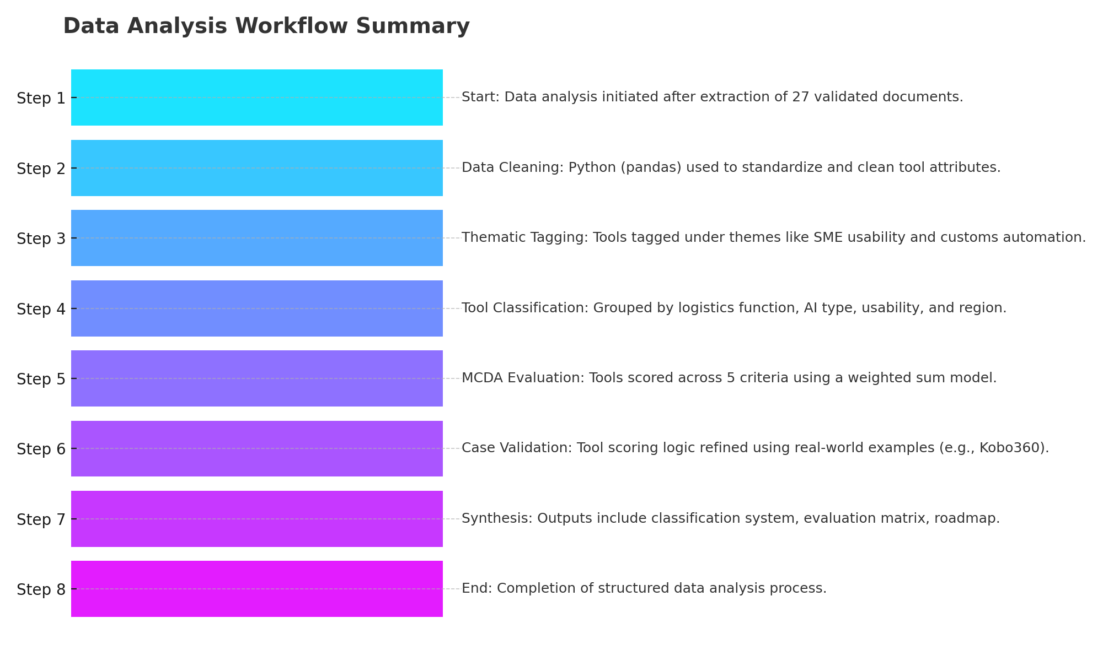
Data Analysis
Used a Python-powered, 8-step analysis to transform data on 65 logistics tools extracted from 27 validated sources into actionable insights. The process combined thematic tagging, tool classification, MCDA scoring, and real-world validation this produced a tool evaluation matrix and strategic roadmap tailored to ATD’s needs.
onwonaagyekum@cmail.carleton.ca
July 15th, 2025
Slide 9

Slide 10
Deliverable 1. PRISMA-ScR Compliant Scoping Review of AI Logistics Tools
66 articles were identified; after removing 6 duplicates and screening titles and abstracts, 27 full-text articles met the inclusion criteria and were included in the final scoping review.
Stage | Count | Description
Records identified from academic databases | 45 | Scopus, Web of Science, IEEE Xplore, ABI/INFORM
Records identified from grey literature sources | 21 | McKinsey, World Bank, DHL, vendor pages, etc.
Duplicates removed before screening | 6 | Identified using AI script
Records screened (title/abstract) | 60 | Screened using inclusion/exclusion criteria
Records excluded at screening | 33 | Lacked AI/logistics/Cross-border trade alignment
Full-text articles assessed | 27 | All passed availability and relevance checks
Full-text articles excluded | 0 | —
Studies included in review | 27 | Final articles used for data extraction
onwonaagyekum@cmail.Carleton.ca
Slide 10

Slide 11
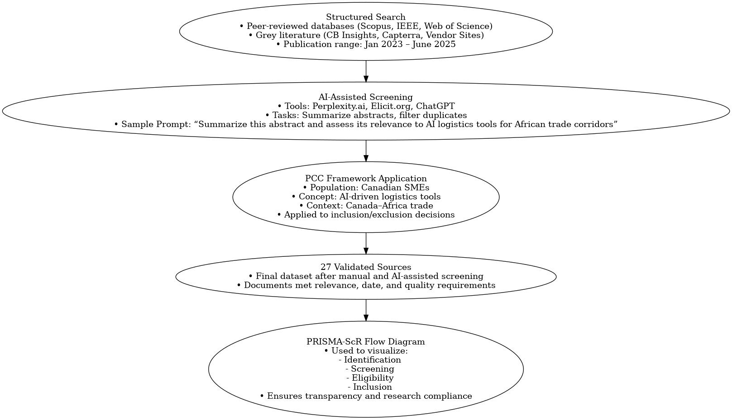
Deliverable 1. Process Used
onwonaagyekum@cmail.carleton.ca
July 29th, 2025
Slide 11
Notes:
11

Slide 12
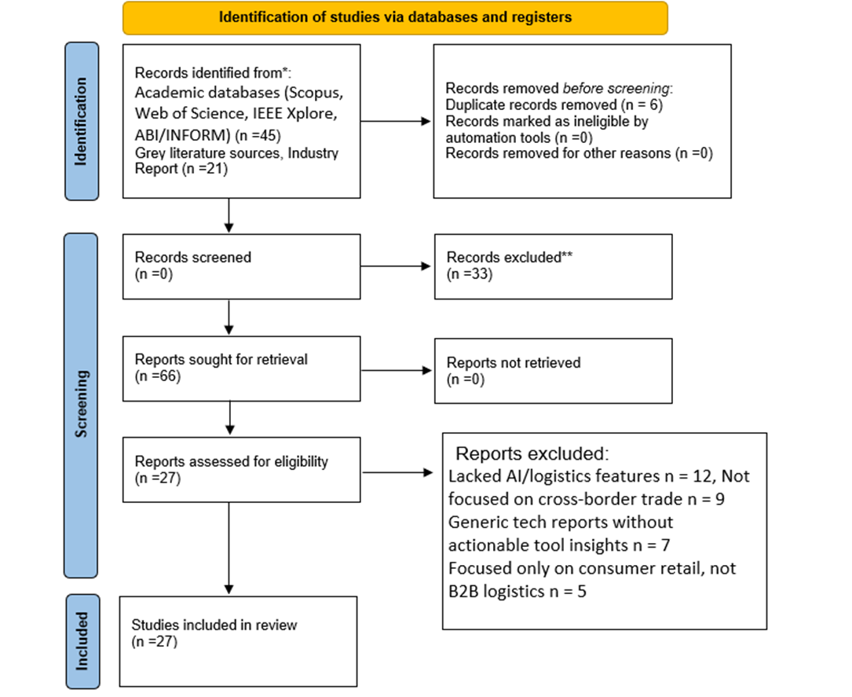
PRISMA-ScR Compliant Scoping Review of AI Logistics Tools
July 29th, 2025
Slide 12

Slide 13
Deliverable 2. Classification System
Classification Method – From Tool Features to Business Functions
65 AI logistics tools were analyzed from Deliverable 1.Each tool was tagged based on its core business function.
Tags were grouped thematically into 5 categories that reflect common logistics pain points.
Categories align with client needs expressed during consultation (e.g., automation, lean staffing, real-time visibility).
July 29th, 2025
Slide 15

Slide 14
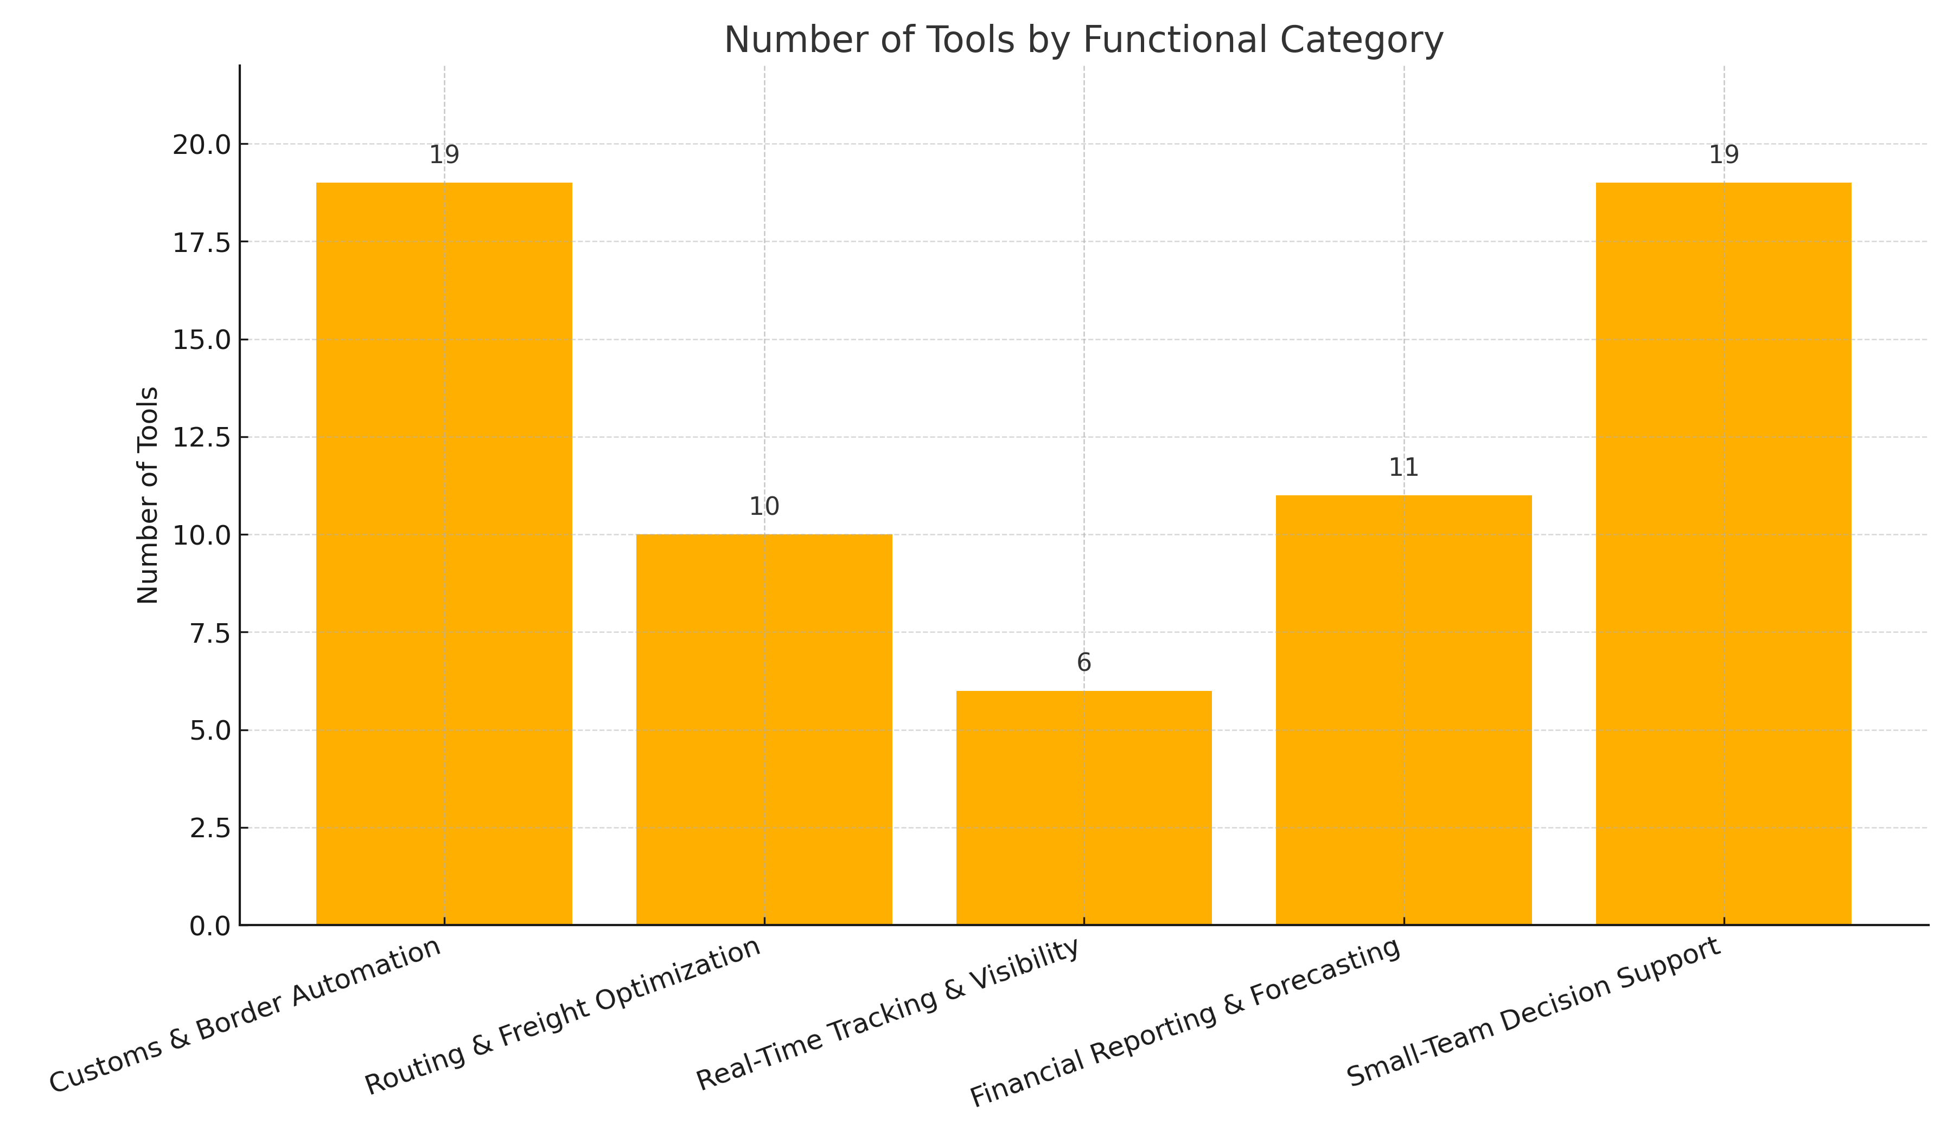
Deliverable 2. Classification System
July 29th, 2025
Slide 15

Slide 15
Deliverable 2. Classification Based on - Customs & Border Automation
These tools address delays, errors, and inefficiencies in customs clearance, compliance,
and cross-border document processing.
Tool | Tool
KlearNow.AI | Web Scraping Tool (NCTC Bot)
Altana Atlas | Risk Management Dashboards
TradeSun | HS Code Anomaly Detector
Supplier Codification Model | Geospatial Data Intelligence System
Network Analytics Model | BERT-Based Misclassification Detector
Entity Profiling Model | WCO Data Analysis Dashboard
Mirror Analysis System | AI-Based OCR (Customs)
Import Valuation Anomaly Model | NCTC Web Scraper Bot
Multidimensional Hopping Model | AI-based X-ray Image Analytics (YOLOv7)
AI-based OCR Module
July 29th, 2025
Slide 16

Slide 16
Deliverable 2. Classification Based on - Routing & Freight Optimization
These tools solve routing inefficiencies by optimizing freight movement, reducing transport costs, and improving delivery reliability.
Tool | Tool
Flexport | Multi-Modal Transport Optimizer
Kobo360 | Cargo Routing Optimizer
Freightos | Quantum AI for Routing
AI for Transportation Routing | Autonomous Vehicles
AI for Route Optimization | AI Route Optimization
July 29th, 2025
Slide 17

Slide 17
Deliverable 2. Classification Based on - Real-Time Tracking & Visibility
These tools fill visibility gaps by providing real-time tracking, disruption alerts, and estimated time of arrival (ETA) predictions across the supply chain.
Tool | Tool
project44 Movement | Digital Twin Systems
Portcast | Digital Twin for Air Cargo
AI Real-Time Visibility Tools | Azure Synapse ML
July 29th, 2025
Slide 17

Slide 18
Deliverable 2: Classification Based on- Financial Reporting & Forecasting
These tools tackle the challenge of poor forecasting by enabling accurate demand planning, inventory control, and financial prediction.
Tool | Tool
Time Series Surge Detection Tool | AI Facility Flow Forecaster
AI for Demand Forecasting | Joint Replenishment Optimizer
AI for Inventory Optimization | Perishable Inventory AI Planner
AI Predictive Analytics | Omnichannel Fulfillment AI
AI Demand Forecasting Engine | AI Inventory Management System
ML-Based Inventory Optimizer
July 29th, 2025
Slide 17

Slide 19
Deliverable 2: Classification System - Based on Small-Team Decision Support
These tools support lean teams by automating tactical decisions, simplifying workflows, and reducing manual effort through AI.
Tool | Tool
AI for Supply Chain Resilience | Cassava Crop Disease Detector
AI for Operational Efficiency | Google Translate (African LLM Expansion)
AI for Enhanced Decision-Making | MedLM
Generative AI (ChatGPT, LLMs) | CoDoC
Explainable AI (XAI) | Gemma
No-Code AI Logistics Builder | AlphaFold
AI-Enhanced Workflow Engine | AI Fraud Detection Systems
AI Chatbots | AI Robotic Systems
AI Chatbot for Shipment Status | AI for Predictive Maintenance
Jacaranda AI Maternal Health Tool
July 29th, 2025
Slide 17

Slide 20
Deliverable 3: Tool Evaluation Matrix
Approach: We used Multi-Criteria Decision Analysis (MCDA) to evaluate 65 AI logistics tools and rank their fit to ATD’s Canada Africa priorities.
Evaluation dimensions (weighted 1–5)
Integration Readiness — How quickly a 1–5-person team can connect (APIs/connectors, CSV/Excel, SSO) without engineers.
Scalability — Ability to grow lanes/users/shipments without re-platforming; reliable performance and SME-friendly pricing.
Real-Time Visibility — Live event updates, predictive ETAs, and exception alerts across carriers (not just periodic status pages).
Ease of Use — Day-one usability for non-technical staff; no/low-code setup, clear UI, templates, mobile access.
Cost Efficiency — Low total cost-to-serve (license + setup + usage) with measurable reduction in manual touches.
Paperwork & Reports Automation — Customs/compliance docs (HS codes, auto-forms, OCR/IDP) plus exportable ops/finance reports.
Scoring outcome : Top performers consistently excelled in Scalability, Real-Time Visibility, and Paperwork & Reports Automation—capabilities that drive efficient cross-border operations.
Validation & sensitivity checks :
Sensitivity analysis: Tested alternate weight vectors (Cost↑, Integration↑, Visibility↑). Top-2 (Flexport & KlearNow.AI) ranking stayed stable.
Case-study validation: Shortlist cross-checked with real use cases (e.g., KlearNow.AI, Flexport, Kobo360).
Transparency: Full criteria, weights, and calculations are documented in Report Ch. 3–4 & Appendix C. (Note: Sensitivity checks, and case-study validation included. See Report Ch. 3–4 & Appendix C.)
July 29th, 2025
Slide 18

Slide 21
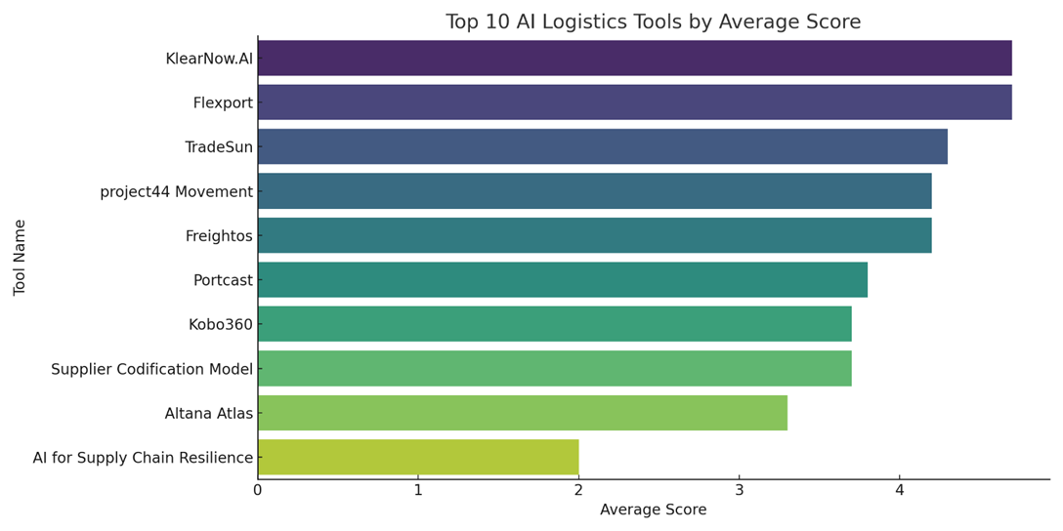
Deliverable 3. Top-Ranked Tools Based on MCDA Scores
This chart shows the top 10 tools based on their average evaluation scores.
• Flexport and KlearNow.AI clearly lead with a score of 4.7.
• Freightos, TradeSun, and project44 Movement also show strong balanced performance.
• The bar heights show how close or far apart tools are in total value, which supports prioritization.
July 29th, 2025
Slide 19

Slide 22
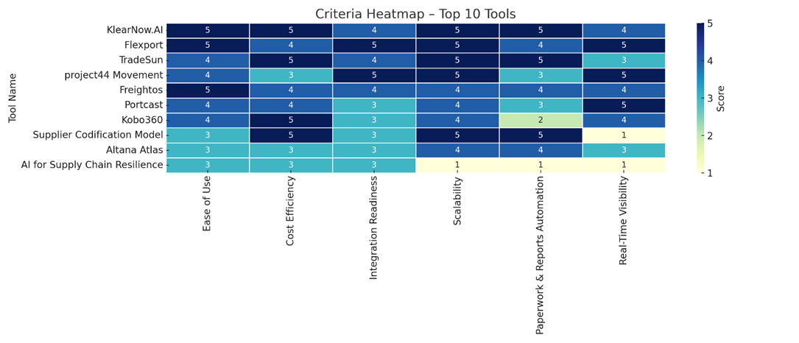
Deliverable 3: Performance Comparison (Criteria-Based Performance)
This heatmap shows how each of the top 10 tools performs across the six criteria:
• KlearNow.AI scores high in paperwork automation, visibility, and usability — ideal for customs workflows.
• Flexport is an all-rounder: strong integration, visibility, and scalability.
• project44 shines in integration and real-time visibility.
• Tools like Kobo360 and Portcast show mid-range performance, suitable for niche needs.
The heatmap helps identify tools that excel in specific categories even if their total score isn't the highest.
Heatmap of top 10 criteria-based performance
onwonaagyekum@cmail.Carleton.ca
July 29th, 2025
Slide 20

Slide 23
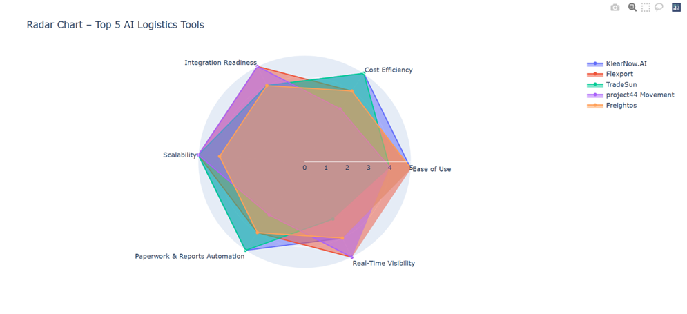
Deliverable 3: Performance Comparison of Top Five Tools
The radar chart visually compares the top 5 tools across all six evaluation criteria:
Flexport and KlearNow.AI show wide, balanced coverage ideal for ATD’s multi-functional needs.
TradeSun shows exceptional scores in paperwork and cost efficiency.
project44 is the leader in integration and real-time visibility, critical for shipment tracking.
Freightos perform well with ease of use and cost but show moderate scalability.
Radar Chart: Top 5 Tools Comparison
onwonaagyekum@cmail.Carleton.ca
July 29th, 2025
Slide 20

Slide 24
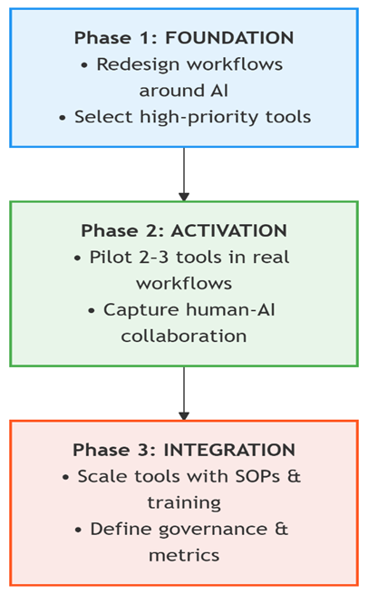
Deliverable 4: Implementation Roadmap-
AI-First
Deliverable 4 operationalizes the AI-First philosophy by designing a roadmap for the Africa Trade Desk (ATD) that places AI tools not as auxiliary enhancements, but as central actors in business functions—aligning with the core concept of AI-First businesses (Furrier, 2024; Mollick, 2025). This roadmap builds on Deliverables 1 to 3.
AI-First Roadmap Flow Diagram
July 15th ,2025
Slide 22

Slide 25
Deliverable 4: Implementation Roadmap-
AI-First
Phase 1: Foundation – Embed AI Capabilities
Objective: Build strategic groundwork for AI-first adoption.
Redesign logistics workflows around AI use cases.
Select high-priority tools (from Deliverable 3).
Identify quick-win use cases aligned with ATD’s capacity.
Examples:
KlearNow.AI (customs automation), Flexport (digital freight coordination), TradeSun (compliance).
Outputs: Capability map, use case success criteria, ATD AI-first charter.
Phase 2: Activation – Pilot in High-Impact Workflows
Objective: Test tools under real conditions with human-AI collaboration.
Deploy 2–3 tools in sandbox mode across one supplier cluster.
Assign human “AI overseers” to validate outputs.
Capture real-time feedback (accuracy, usability, speed).
Tool Pilots:
Freightos (freight booking), Portcast (forecasting & tracking), Risk dashboards (sanctions alerts).
Outputs: Pilot KPI dashboard, refinement issues list, go/no-go decision matrix.
July 15th ,2025
Slide 23

Slide 26
Deliverable 4: Implementation Roadmap-
AI-First
Phase 3: Integration – Institutionalize AI with Governance
Objective: Scale proven pilots and mature AI adoption.
Train staff on SOPs & AI decision-support roles.
Define governance metrics (e.g., customs clearance time).
Codify governance: audit logs, fallback procedures, licensing.
Tools to Scale:
Flexport (tracking), KlearNow.AI (customs), project44 Movement (shipment visibility).
Outputs: ATD AI Operations Manual, AI performance review template, license & data plan.
July 15th ,2025
Slide 24

Slide 27
Discussion of Results
Built an evidence base and classified AI logistics tools; evaluated 6 options with an MCDA rubric.
Shortlist & scores: KlearNow.AI (4.7) and Flexport (4.7) lead; project44 (4.2) and Freightos (4.0) are strong alternates; Kobo360 (3.7) and Altana Atlas (3.3) fit niche needs.
Key insight: Biggest near-term wins are customs automation and end-to-end coordination; real-time visibility remains a gap.
Roadmap: AI-first, gated pilot with KPI baselines (ETA error, manual touches, OTIF, lane-onboarding time).
Impact: Fewer manual steps, better ETA/OTIF, faster onboarding—lower-risk adoption for ATD’s Canada–Africa lanes.
July 15th ,2025
Slide 24

Slide 28
Why your project meets your pathway requirements
It’s applied and client-facing. The work solves a real ATD problem using applied research exactly what the M.Eng (TIM) pathway expects (project-based, client problem–solving).Engineering analysis & decisions.
Uses structured methods (MCDA) and measurable KPIs to design, test, and evaluate solutions consistent with engineering design and evidence-based decision-making in TIM.
Interdisciplinary integration. Blends engineering, business, and data (tool selection, process redesign, ROI), aligning with M.Eng expectations to integrate coursework across these areas.
Commercialization & implementation focus. The AI-first roadmap, pilot plan, and ROI framing reflect emphasis on technology entrepreneurship and readiness for implementation.
Professional communication. Delivers a structured report and presentation that synthesize literature, analysis, and recommendations core professional skills developed in the program.
July 15th ,2025
Slide 24

Slide 29
Novelty of The Project
Underexplored corridor: Focuses on the Canada–Africa trade lane—rare in AI logistics research—addressing real needs of Canadian firms working with African suppliers.
Tailored to asymmetrical markets: Provides a classification + evaluation system built for cross-border operations with uneven data, infrastructure, and regulations.
ROI-oriented features: Prioritizes pricing/cost–benefit models, real-time tracking, small-team usability (1–5 users), paperwork automation, and downloadable financial reports.
Actionable now: Translates academic insight into a ready-to-pilot shortlist with KPI gates immediately usable by ATD.
Reusable method: A flexible, replicable research model future TIM projects can apply and extend as new user needs emerge.
July 15th ,2025
Slide 24

Slide 30
Limitations
No primary data yet: Baselines and live pilot results pending; findings are pre-validation.
Grey-literature bias: Vendor claims may be promotional; mitigations applied but residual risk remains.
Visibility gap: Limited evaluation of real-time tracking vendors and integration depth.
Scope & transferability: Built for Canada–Africa SMEs; may not generalize to other corridors or enterprise scale.
Cost/integration uncertainty: Pricing tiers, APIs, and data-sharing agreements not fully verified; ROI is provisional.
Data quality risk: Inconsistent supplier data or low event capture could limit KPI tracking and comparisons.
July 15th ,2025
Slide 24

Slide 31
Suggestions for future research
Run longitudinal pilots: Multi-lane, 6–12-month trials to quantify KPI lift and cost-to-serve.
Refine MCDA with primary data: Elicit weights via AHP/conjoint; add sensitivity analysis.
Deep-dive on visibility tech: Head-to-head tests of real-time tracking (EPCIS events, latency, data completeness, API effort).Model TCO & ROI scenarios: Include licenses, integrations, data fees, training, and change-management costs.
Study human–AI workflows: Oversight protocols, exception rates, user adoption, and failure modes.
Data governance & risk: Data-sharing agreements, privacy/security, and resilience in low-connectivity contexts.
July 15th ,2025
Slide 24

Slide 32
Reference
AI-Obeidat, S., Al-Kilidar, H. & Khan, S. (2023) ‘Artificial intelligence in supply chain logistics: Opportunities and performance metrics’, Journal of Supply Chain Innovation, 18(2), pp. 89–103.
CB Insights (2024) AI logistics startups market map. Available at: https://www.cbinsights.com (Accessed: 14 July 2025).
Furrier, J. (2024). The AI-first enterprise: Rethinking digital transformation with agents at the center. AI Strategy Press.
Jetvision AI (2024) ROI analytics and reporting tools for trade platforms. Available at: https://www.jetvision.ai (Accessed: 14 July 2025).
Kabir, G. & Sadiq, R. (2021) ‘A review of multi-criteria decision-making methods for sustainability assessment of infrastructure systems’, Sustainable Cities and Society, 66, 102652. Available at: https://doi.org/10.1016/j.scs.2020.102652.
Kobo360 (2023) AI logistics solutions for Africa. Available at: https://www.kobo360.com (Accessed: 14 July 2025).
Mollick, E. (2025). Leading with AI: How smart systems reshape small teams and strategy. Harvard Business Review Press.
Petrudi, S.H., Pirayesh, A. & Hashemi, H. (2022) ‘Integrating AI into supply chain cost reporting: Challenges and frameworks’, Journal of Business Analytics, 5(4), pp. 301–318.
Planet Crust (2024) Low-code AI tools for logistics and SMEs. Available at: https://www.planetcrust.com (Accessed: 14 July 2025).
Rahman, K. & Tetteh, D. (2024) ‘Scaling digital logistics in Sub-Saharan Africa: An SME perspective’, African Journal of Logistics and Development, 12(1), pp. 54–70.
Saghafian, S. & Van Oyen, M.P. (2023) ‘Operational challenges and opportunities in Africa-focused supply chains’, International Journal of Operations & Production Management, 43(1), pp. 45–67. Available at: https://doi.org/10.1108/IJOPM-03-2022-0164
Tricco, A. C., Lillie, E., Zarin, W., O’Brien, K. K., Colquhoun, H., Levac, D., ... & Straus, S. E. (2018). PRISMA extension for scoping reviews (PRISMA-ScR): Checklist and explanation. Annals of Internal Medicine, 169(7), 467–473. https://doi.org/10.7326/M18-0850
UNECA (2023) Technology and innovation in African logistics: Regional policy outlook. Addis Ababa: United Nations Economic Commission for Africa.
Wang, Y., Zhao, X. & Huo, B. (2022) ‘The role of artificial intelligence in supply chain visibility: A literature review and future research directions’, Transportation Research Part E: Logistics and Transportation Review, 158, 102611. Available at: https://doi.org/10.1016/j.tre.2022.102611
World Bank. (2023). AI in African Supply Chains: Landscape Review. World Bank Digital Trade Unit Report.

